Slide 1
Currency Recognition System Using ImageProcessing

Slide 2
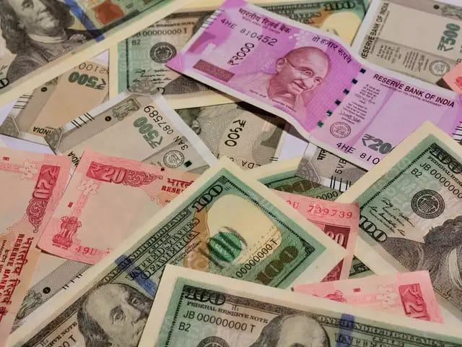
CONTENTS
Abstract
Introduction
Existed System
Proposed System
Architecture
Modules
Requirements
Implementation of Modules
ER Diagrams
UML Diagrams
Screenshots

Slide 3
ABSTRACT
In this paper, we propose a system for automated currency recognition using image processing techniques. The proposed method can be used for recognizing both the country or origin as well as the denomination or value of a given banknote. Only paper currencies have been considered. This method works by first identifying the country of origin using certain predefined areas of interest, and then extracting the denomination value using characteristics such as size, color, or text on the note, depending on how much the notes within the same country differ. We have considered 20 of the most traded currencies, as well as their denominations. Our system is able to accurately and quickly identify test notes.

Slide 4
INTRODUCTION
According to the survey conducted by the CIA, there are around 180+ currencies presently circulating in the world. The need for acquiring knowledge about all the currencies by the banks has been extremely important. However for any human teller to recognize each note correctly is something that is not feasible. Thus the need for an efficient automated system that helps in recognizing notes is pivotal for the future. In this paper, we propose an automated system for currency recognition using Image processing techniques. We aim to build our system in a way that it is easily scalable and gives an accurate result.

Slide 5
EXISTED SYSTEM
The varying features in each notes and the security aspects involved in different currencies make this task extremely difficult.
However not a single method has proven to be efficient enough for actual development.
Thereby making this problem statement an interesting area of research.

Slide 6
PROPOSED SYSTEM
In this paper, we propose an automated system for currency recognition using Image processing techniques.
The system proposed then applies a series of pre-processing steps on the input images and then extracts certain features such as hue, saturation and value parameters
Note that this is requires less comparisons than checking the image against all templates of every country in the system

Slide 7
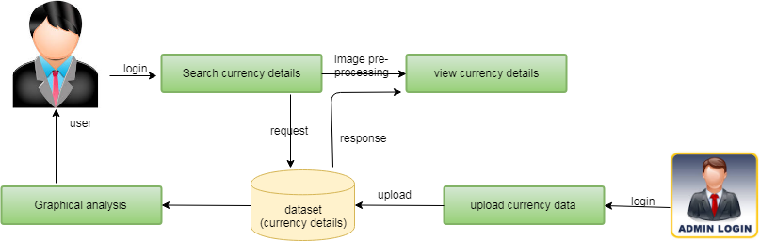
ARCHITECTURE

Slide 8
MODULES
Upload Currence Data
Classification Using Algorithm
Image Preprocessing
Graph Analysis

Slide 9
Software Requirements:
Python
Django
Mysql
Wampserver
Hardware Requirements :
Processor: Pentium IV or higher
RAM: 256 MB
Space on Hard Disk: minimum 512MB

Slide 10
Implementation of Modules :
1.UPLOAD CURRENCE DATA :
The data can be uploaded by admin without any particular scenario but with the details of currency. The most importantly large amount of can be handled in order to do practically. The data that are handling throughout the project can be done in this module. Users have permission to view data but not edit the data in online they can request the user to get the data.

Slide 11
2.CLASSIFICATION USING ALGORITHM :
The data can be categorized by the k means clustering algorithm based on the some scenarios. The data can be cluster with various factors in order to get data properly. The k-means clustering algorithm is applied on the large scale data to access the details in perfect manner.

Slide 12
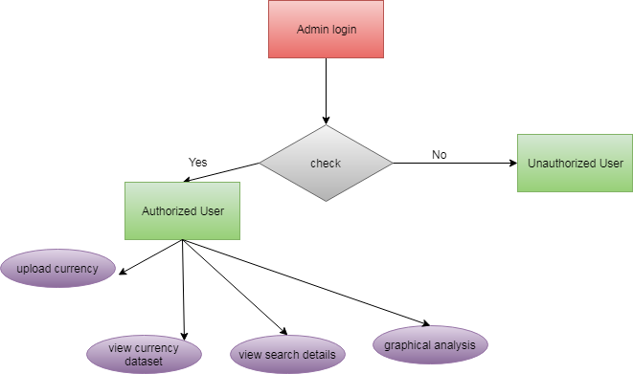
ER Diagram(Admin)

Slide 13
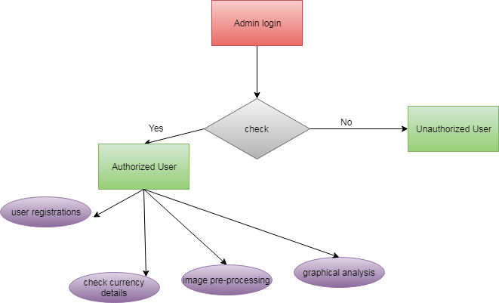
ER Diagram(User)

Slide 14
UML Diagrams
Component Diagrams
Use case Diagrams
Class Diagrams
Data flow Diagrams
Activity Diagrams
Sequence Diagrams

Slide 15
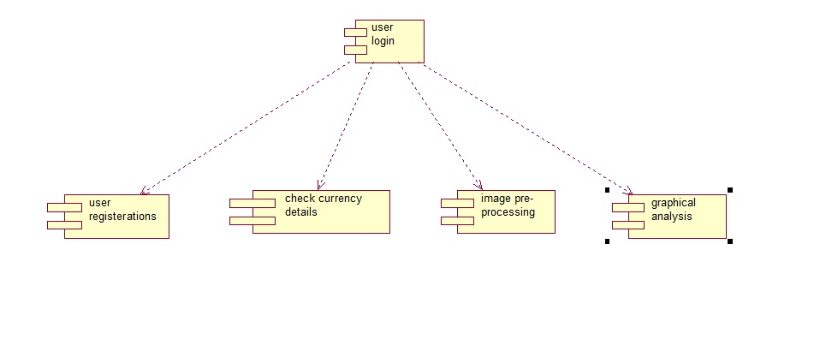
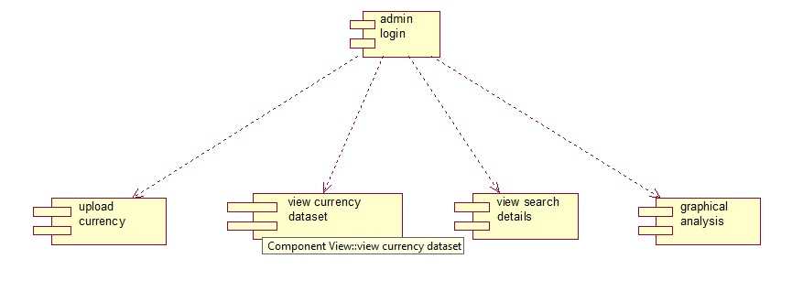
Component Diagrams
USER
User
Admin
ADMIN

Slide 16
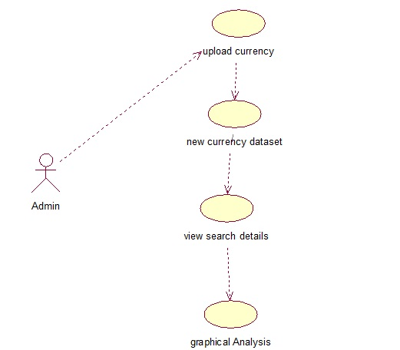
Usecase Diagram(Admin)
User
Admin

Slide 17
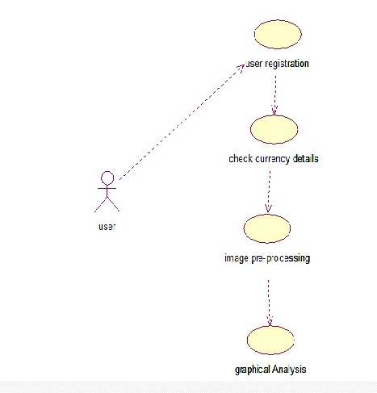
Usecase Diagram(User)

Slide 18
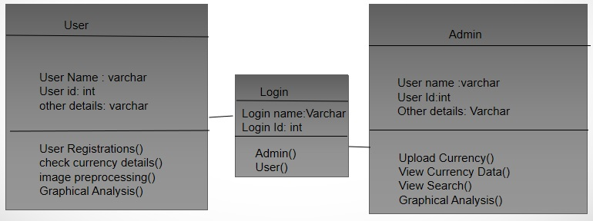
CLASS DIAGRAM

Slide 19
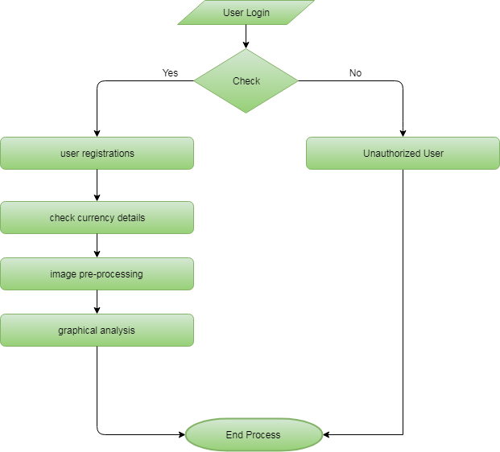
Data Flow Diagram(User)

Slide 20

Data Flow Diagram(Admin)

Slide 21
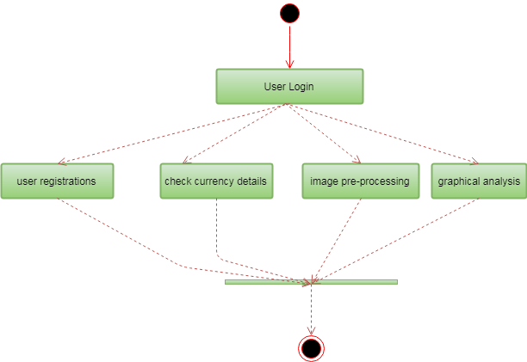
Activity Diagram(User)
Start
End

Slide 22
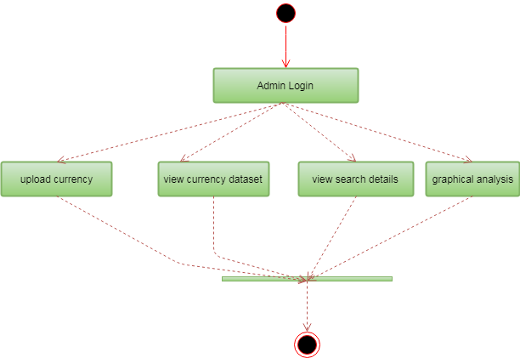
Activity Diagram(Admin)
Start
End

Slide 23
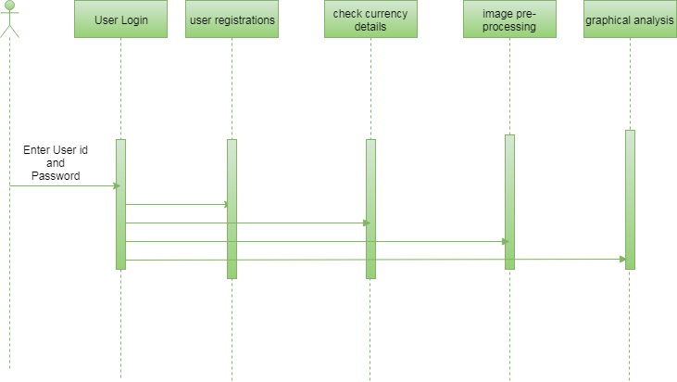
Sequence Diagram(User)

Slide 24
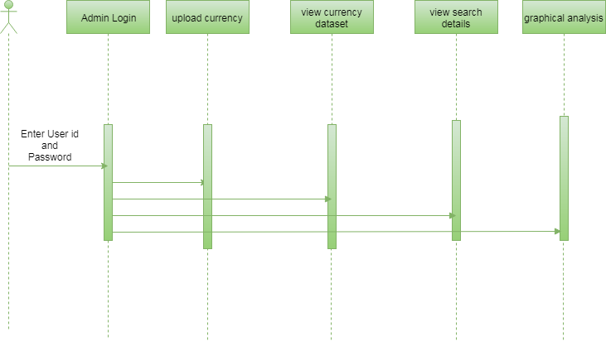
Sequence Diagram(Admin)

Slide 25
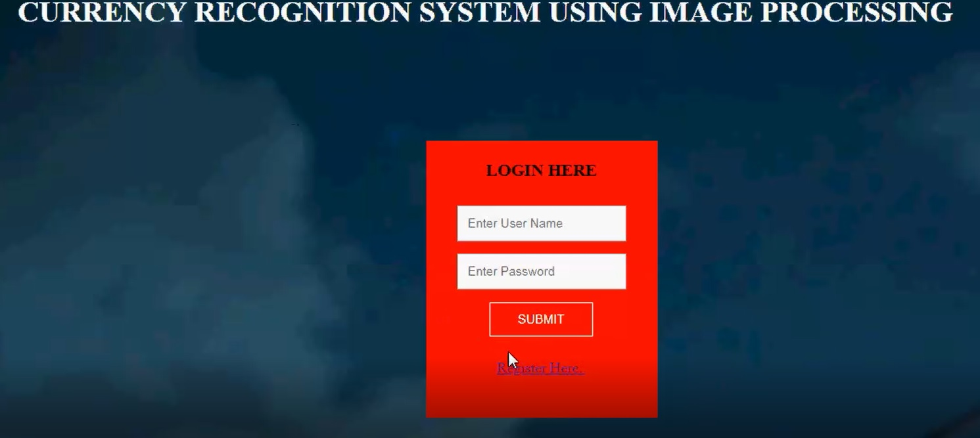
LOGIN HERE

Slide 26
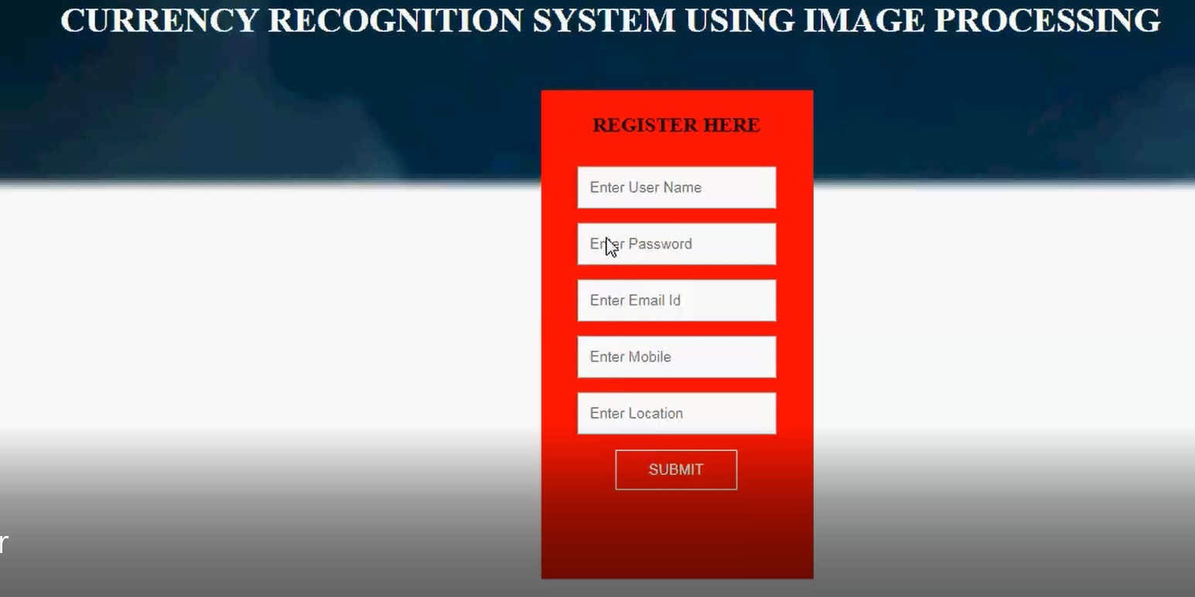
REGISTER PAGE

Slide 27
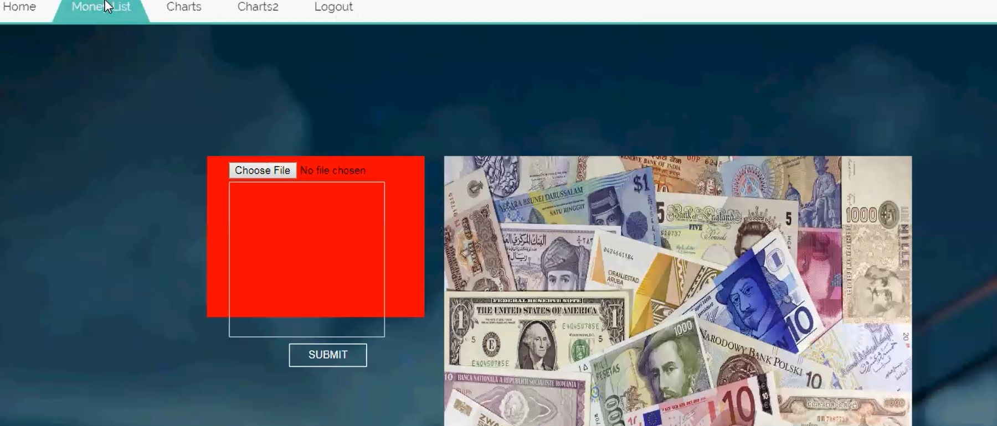
CHECK CURRENCY

Slide 28
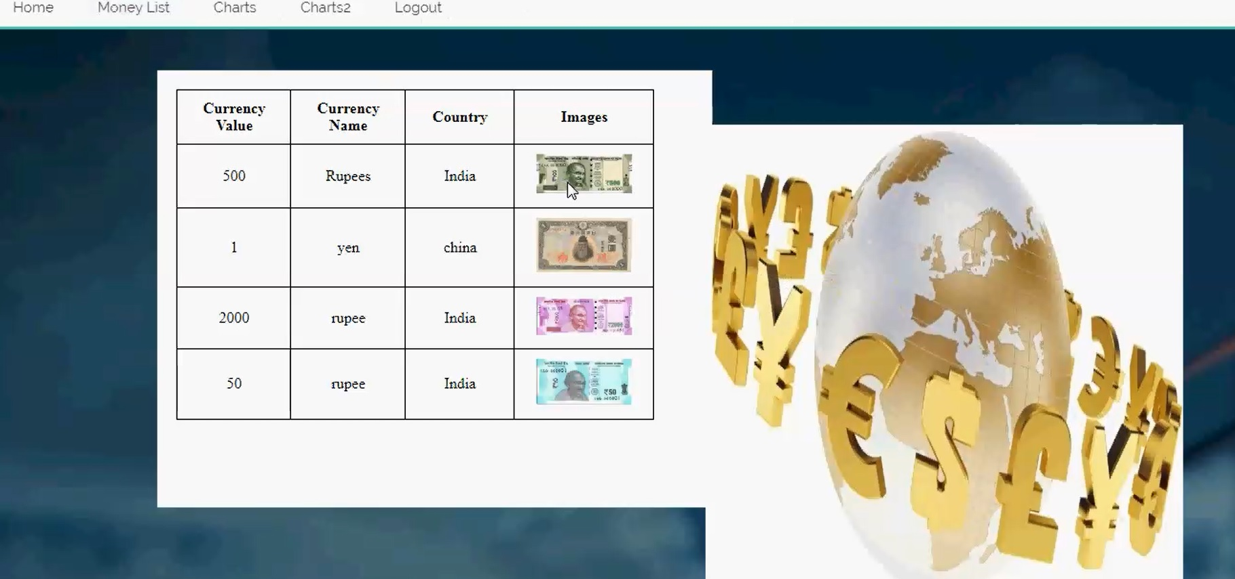
SEARCH DETAILS

Slide 29
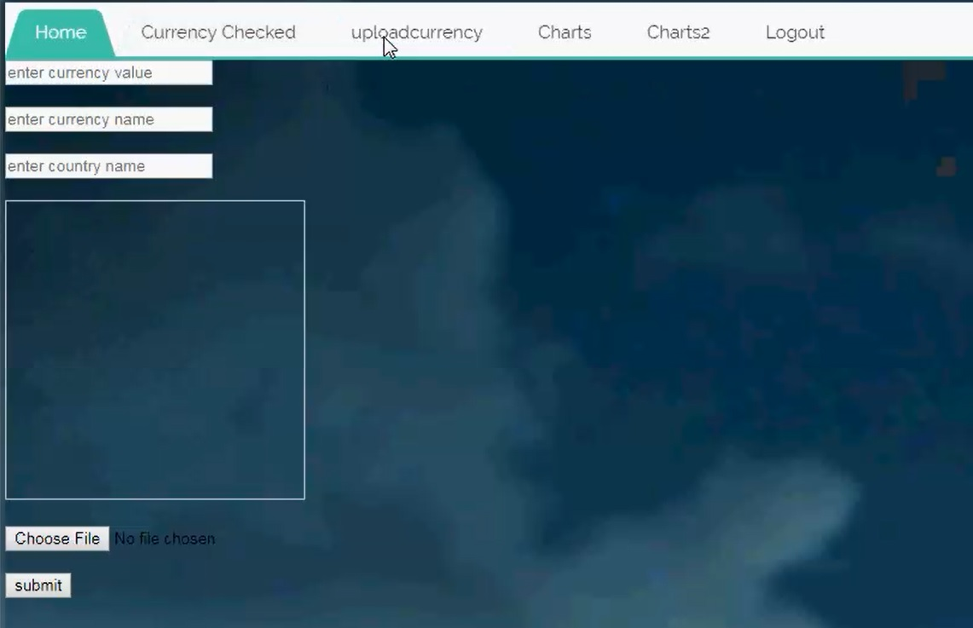
UPLOADED CURRENCY DETAILS

Slide 30
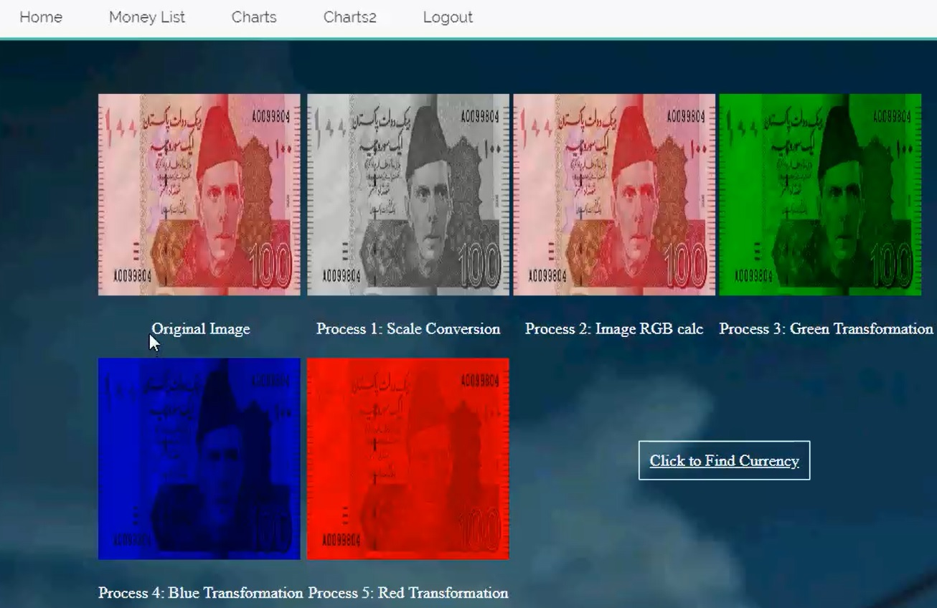
IMAGE PRE-PROCESSING

Slide 31
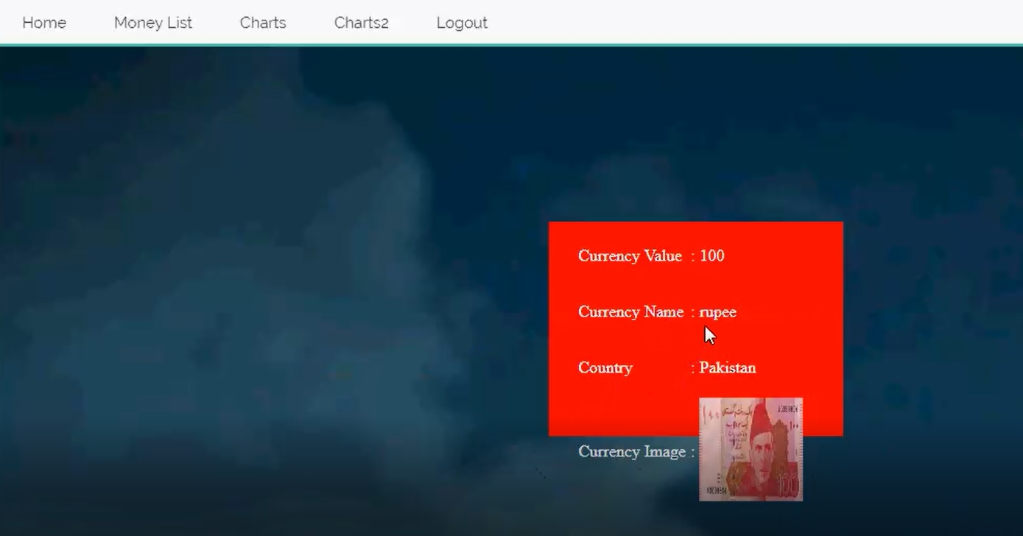
VIEW CURRENCY

Slide 32
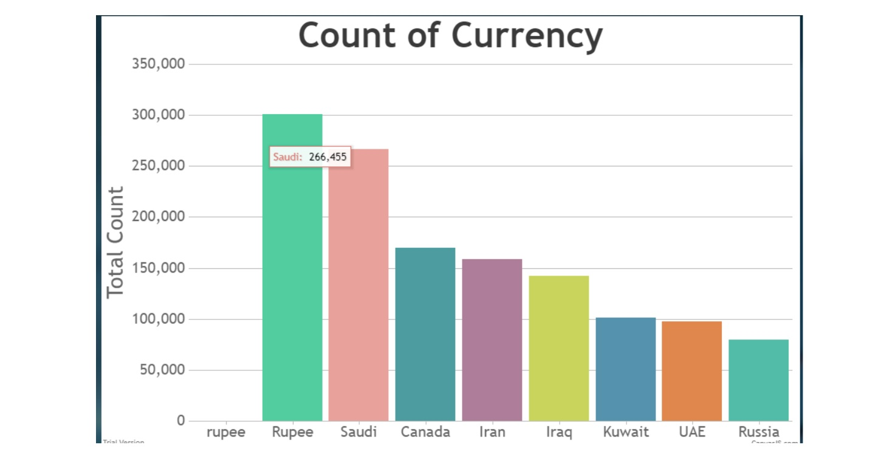
GRAPHICAL ANALYSIS

Slide 33
CONCLUSION
In conclusion, we have designed a system that accurately identifies both the country of origin and the denomination of a given banknote. Our system currently supports twenty of the most common currencies, but can easily be extended to more countries based on the method we have previously described. When compared with the crude algorithm of pixel by pixel comparison, our algorithm is considerably more accurate, and takes less time. We have thus learned that our proposed algorithm is able to identify currency and denomination in an average of 5.3 seconds, which is a considerable improvement over the crude algorithm. However, our proposed system only considers a limited number of currencies. There are 180+ currencies that can be included in the system, and we have chosen to only do for 20 of the most common ones. Also, the system should be effective in identifying notes that are mutilated. Our system is not effective under this consideration. This can be worked on in the future.

Slide 34

Any Queries??? & Thank You!!!

